Slide 1
Cereal Analysis and Clustering
Anderson, Taylor
Lawrence, Jonathan

Slide 2

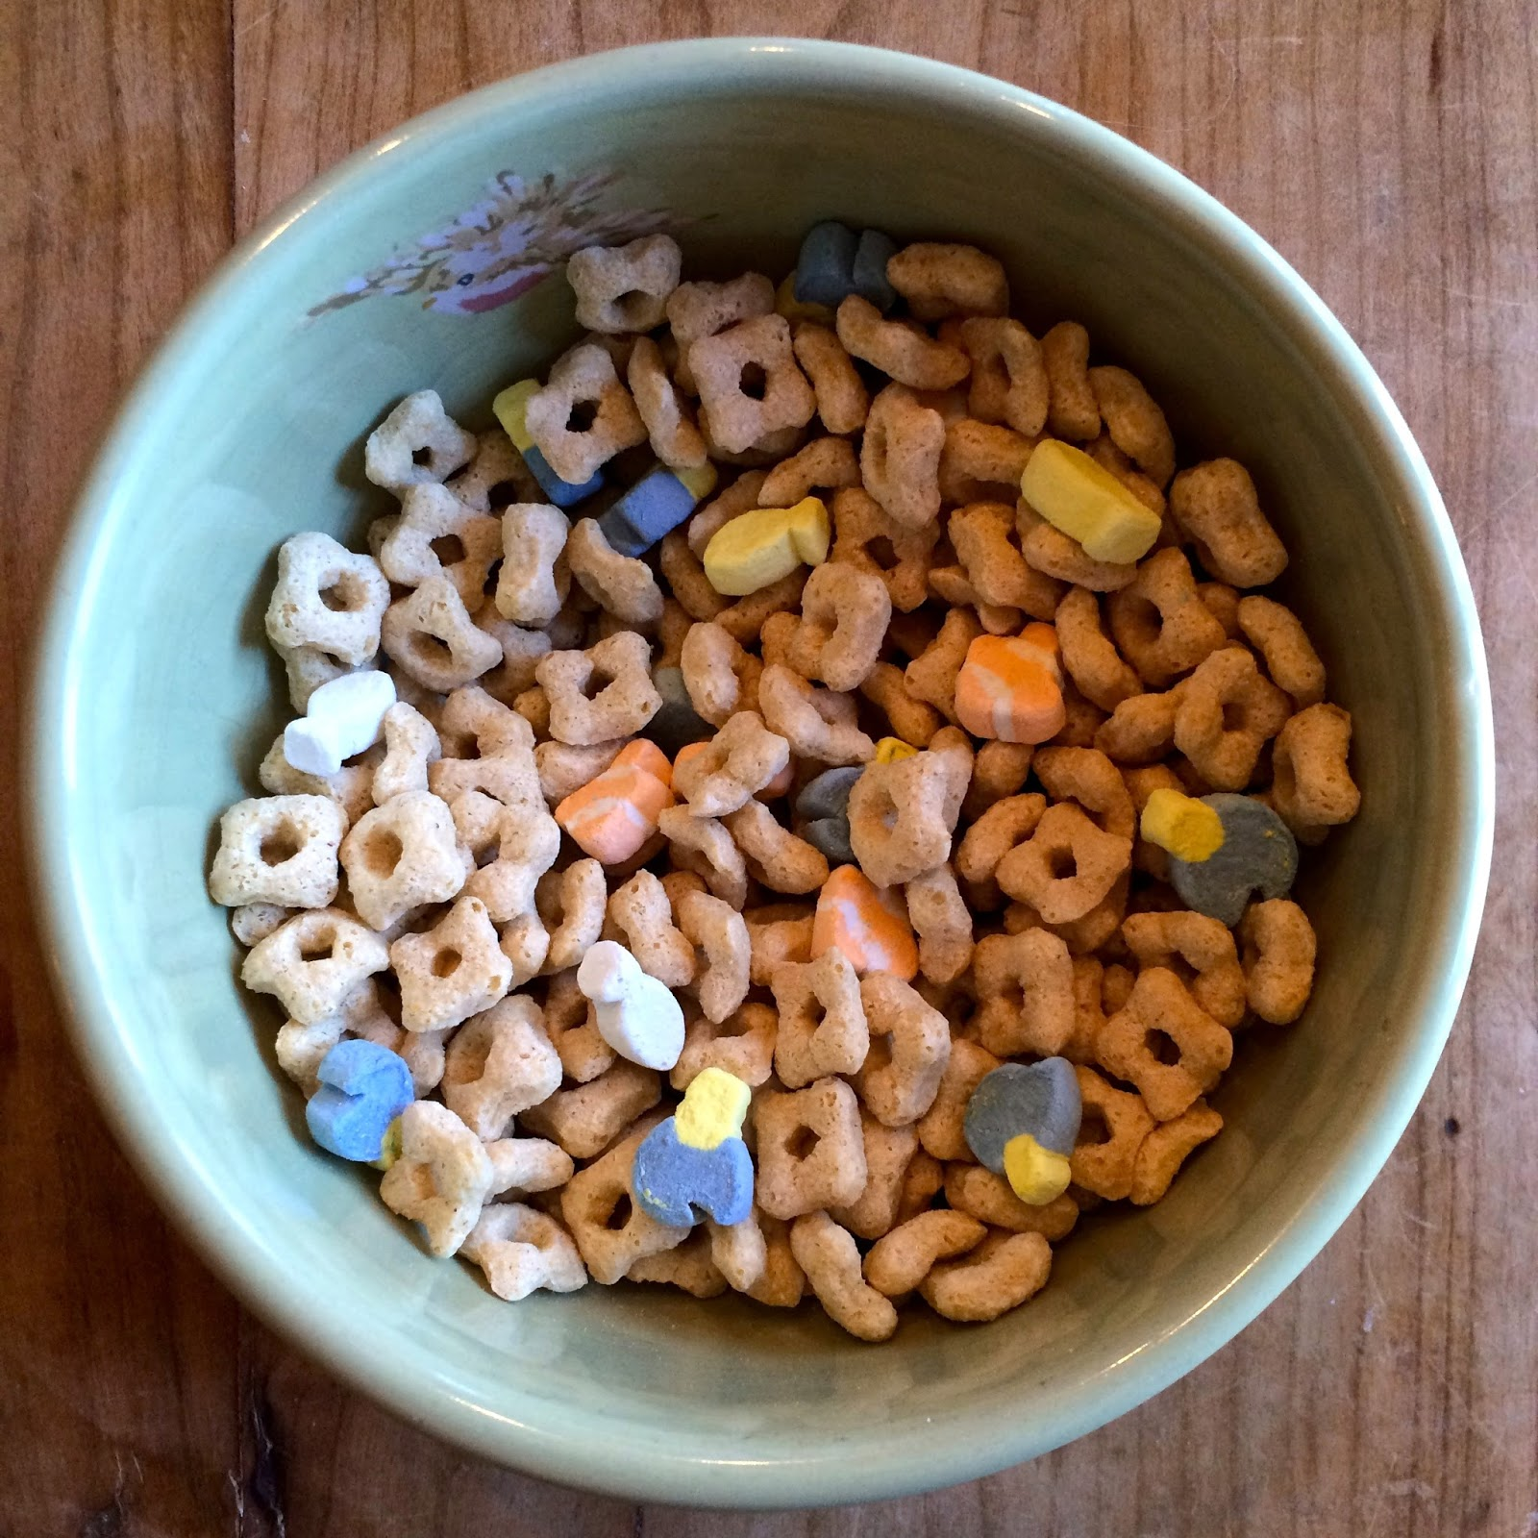
Project Goal
Hypothesis
The assumption of most people is that cereal brands that are labeled as ‘healthy’ are actually not all that healthy. There are arguments that all cereal is unhealthy, despite the labeling.
Analysis
The purpose behind this course project is to use exploratory data analysis, clustering techniques, and correlation analysis to determine the healthiness, or lack thereof, of different cereals.

Slide 3
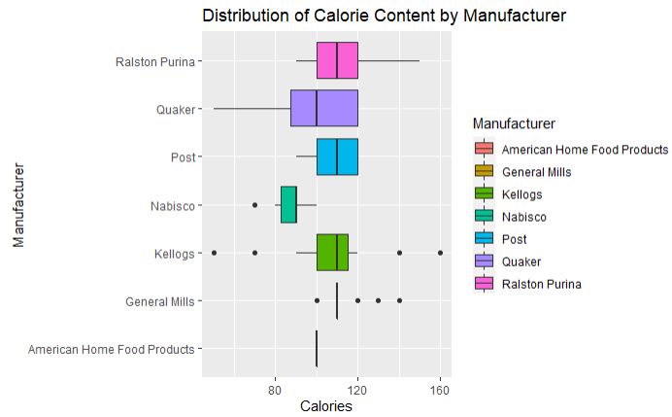
EDA: Distribution of Calorie Content by Manufacturer
The difference in the average value of individual features between the brands was not significant enough to indicate brand bias.
Graph of Calorie Content presented as an example.

Slide 4
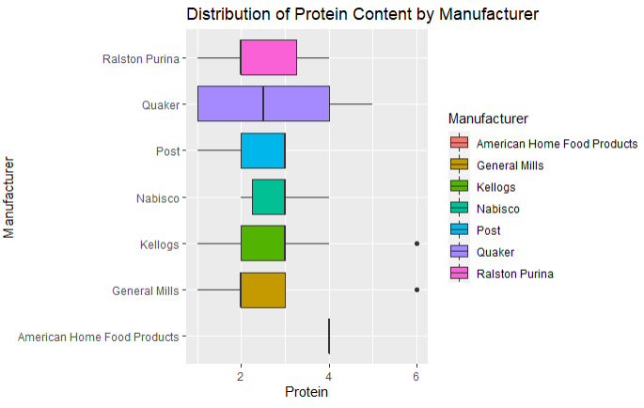
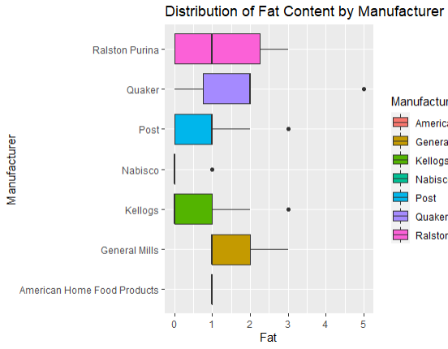
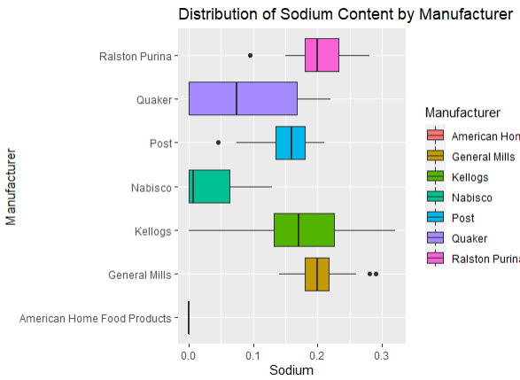
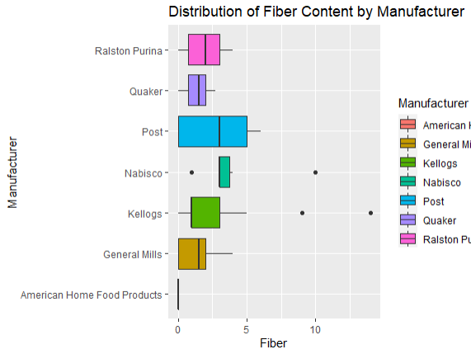
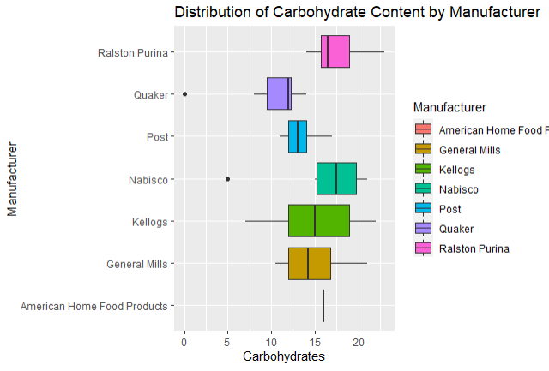
EDA: Additional Distributions of Nutritional Content by Manufacturer
Graphs of other nutritional features

Slide 5
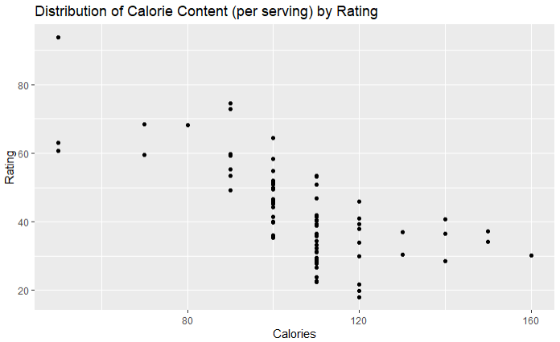
EDA: Distribution of Calorie Content (per serving) by rating
Replaced manufacturer with the rating in our analysis
This led to some significant insights

Slide 6
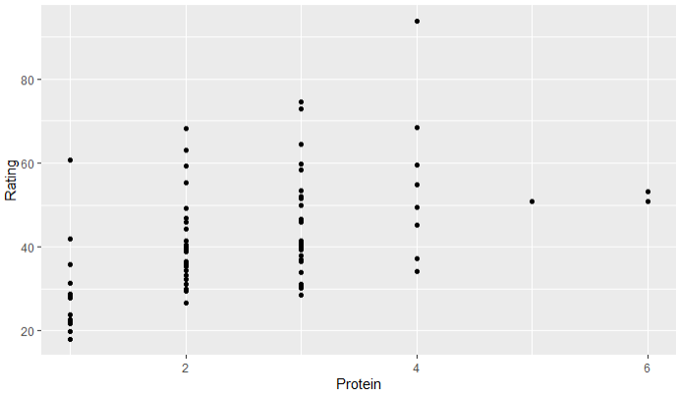
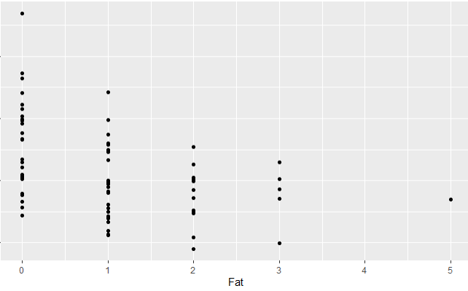
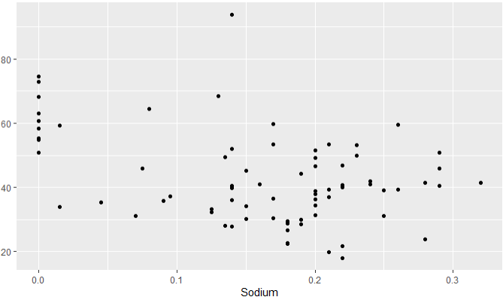
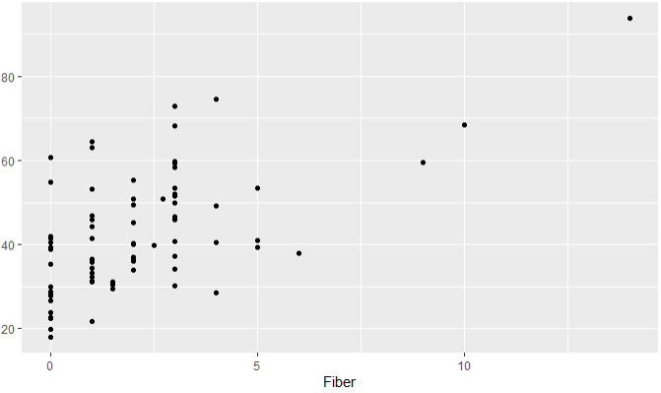
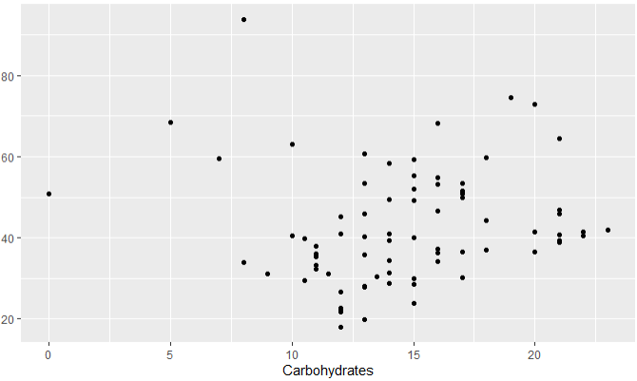
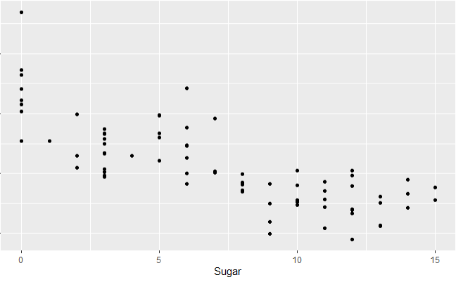
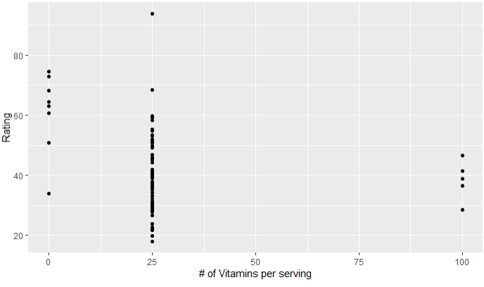
EDA: Additional Distribution of Nutritional Content (per serving) by rating
Graphs of other nutritional features

Slide 7
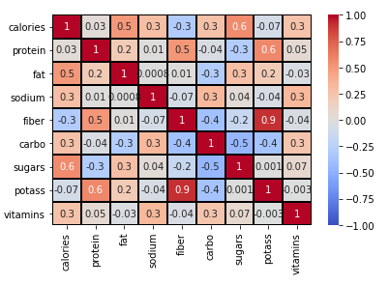
Regression Feature Selection
Feature Selection Methods
Correlation Heatmap
Recursive Feature Elimination
Removed features
Manufacturer
Type
Potassium
Vitamins

Slide 8
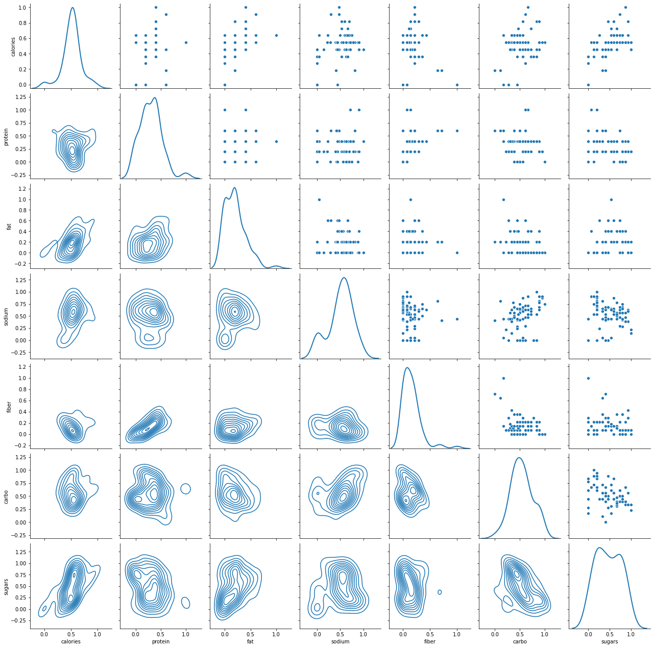
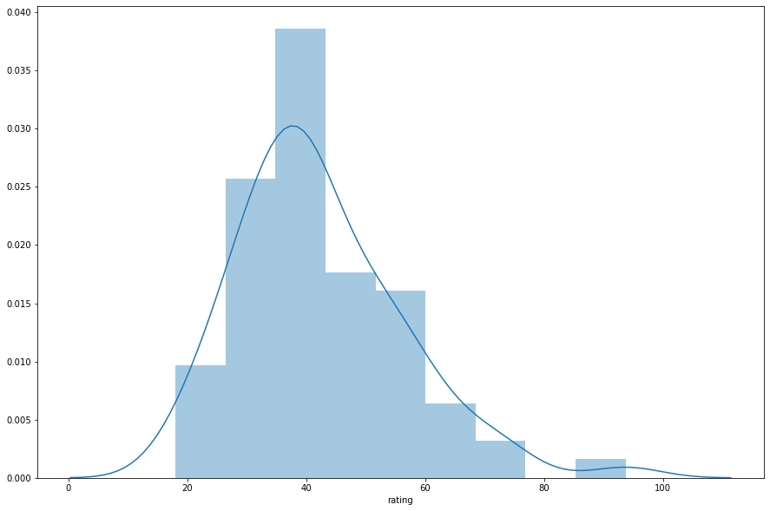
Regression Features

Slide 9
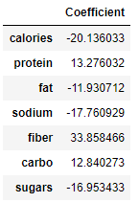
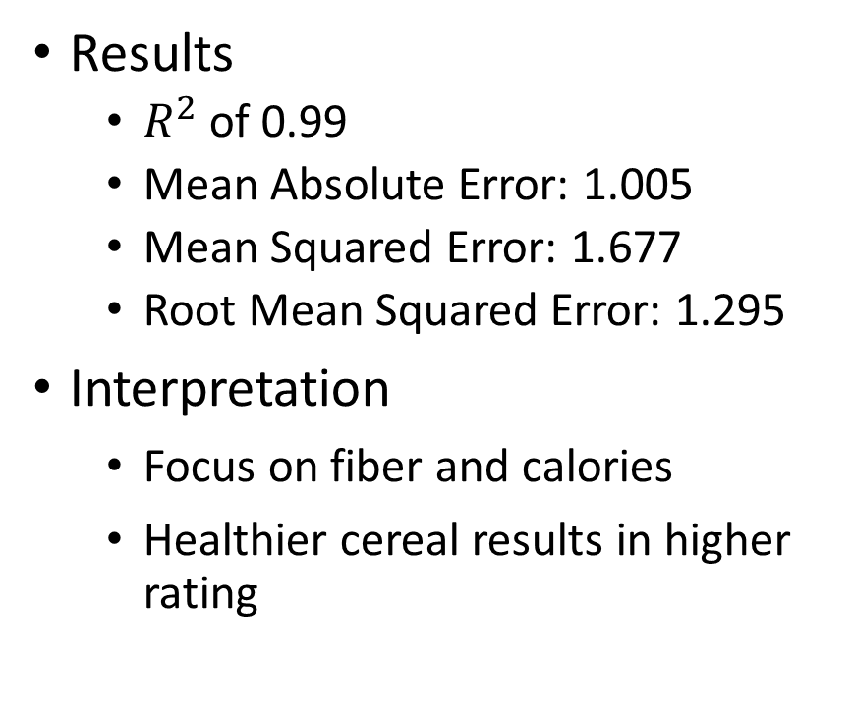
Regression Results
Results
$R^{2}$ of 0.99
Mean Absolute Error: 1.005
Mean Squared Error: 1.677
Root Mean Squared Error: 1.295
Interpretation
Focus on fiber and calories
Healthier cereal results in higher rating

Slide 10
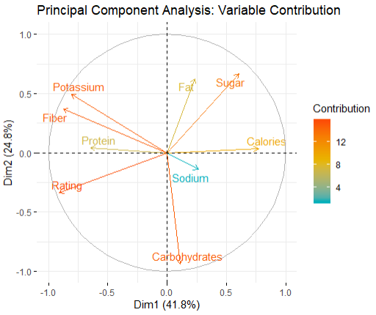
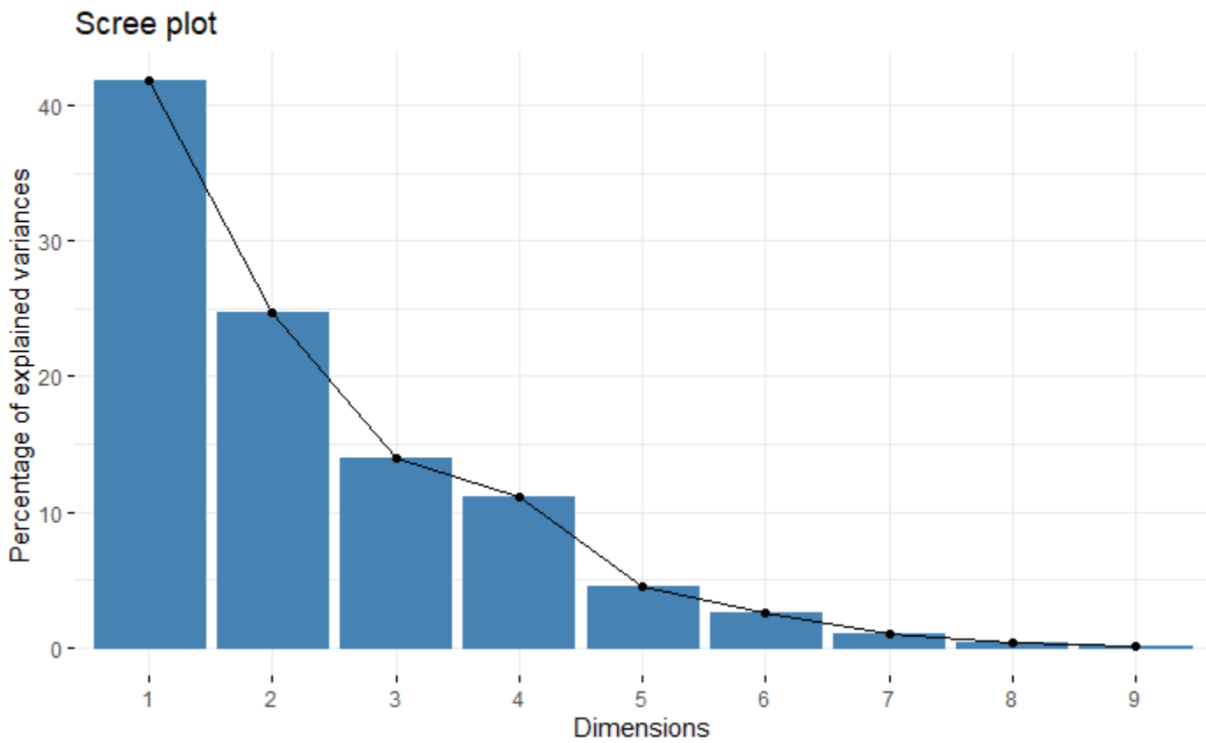
Principal Component Analysis

Slide 11
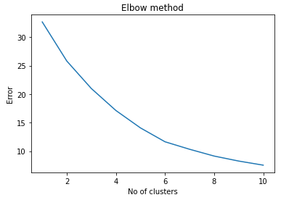
K-Means: Elbow Test
Elbow test suggests no best-case number of clusters
We’ve chosen to use two clusters since that works with our project goal

Slide 12
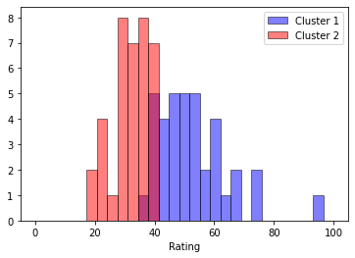
K-Means: Bar Graph of Clusters
“Good for you” = Cluster 1
“Bad for you” = Cluster 2
The purple area indicates overlap between the clusters.

Slide 13
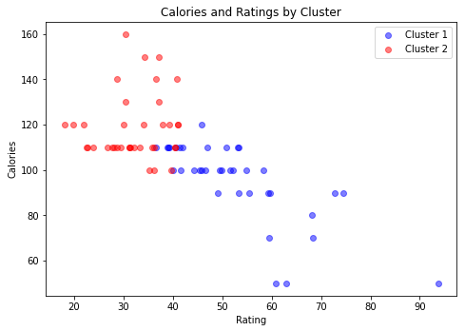
K-Means: Scatterplot of Clusters (based on Calories)
“Good for you” = Cluster 1
“Bad for you” = Cluster 2
Calorie content has a negative correlation to rating.

Slide 14
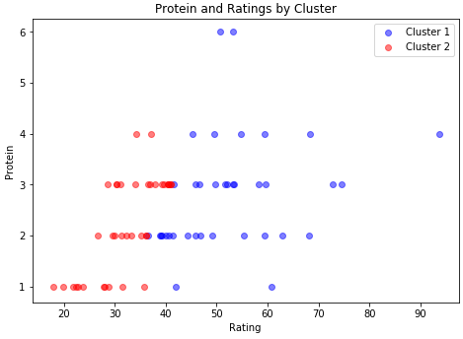
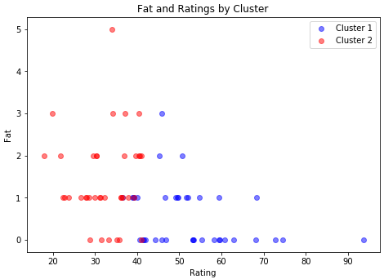
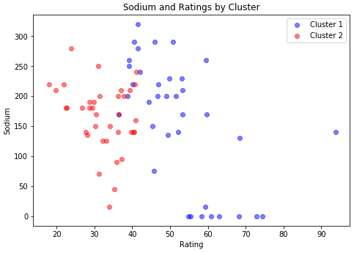
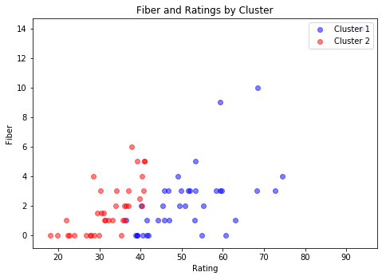
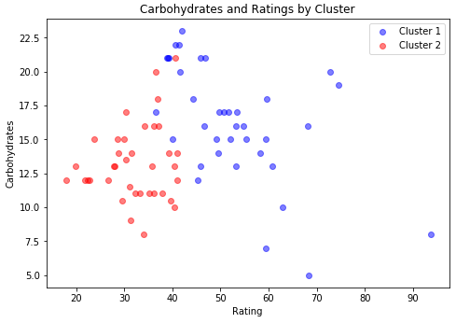
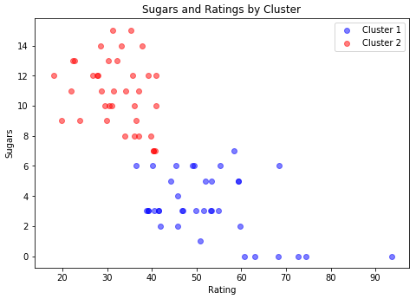
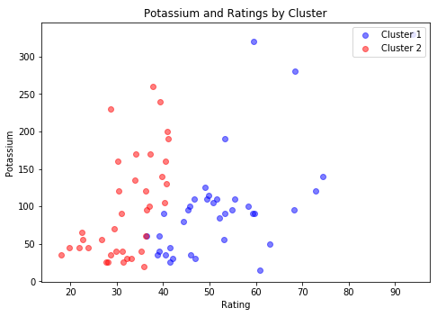
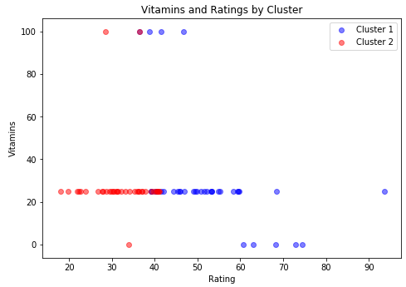
K-Means: Additional Scatterplots of Clusters
“Good for you” = Cluster
“Bad for you” = Cluster 2

Slide 15
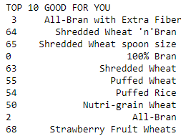
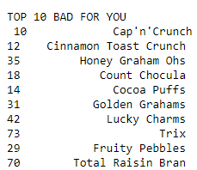
Results: Top 10 Lists
Generated top 10 “good for you” and “bad for you” lists
Results are as expected, which indicates the analysis was performed admirably

Slide 16
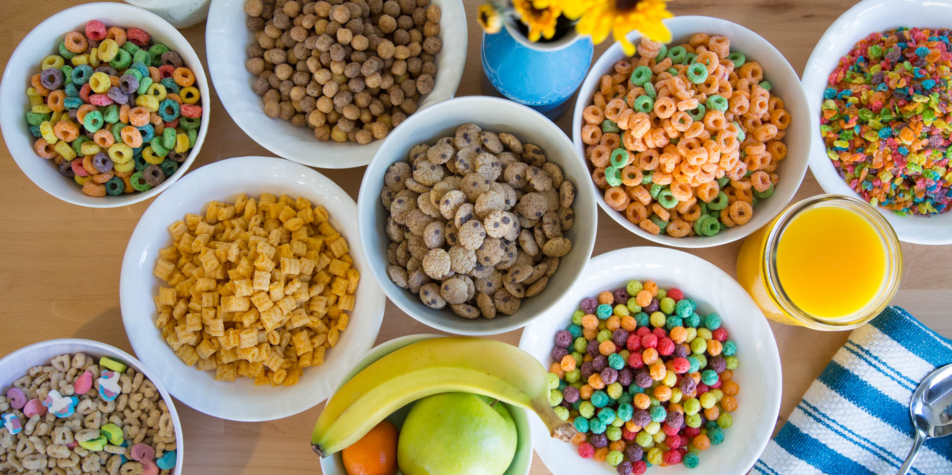
THANKS FOR YOUR TIME!

